Slide 1
Multiple Aggregations Over
Data Streams
Rui Zhang National Univ. of Singapore
Nick Koudas Univ. of Toronto
Beng Chin Ooi National Univ. of Singapore
Divesh Srivastava AT&T Labs-Research

Slide 2
Outline
Introduction
  Query example and Gigascope
  Single aggregation
  Multiple aggregations
  Problem definition
Algorithmic strategies
Analysis
Experiments
Conclusion and future work
Notes:
First let’s look at an example of aggregation query in network data stream and Gigascope, the data stream system our study is based on.

Slide 3
Aggregate Query Over Streams
Select tb, SrcIP, count (*)
from IPPackets
group by time/60 as tb, SrcIP
More examples:
  Gigascope: A Stream Database for Network Applications (SIGMOD’03).
  Holistic UDAFs at Streaming Speed (SIGMOD’04).
  Sampling Algorithms in a Stream Operator (SIGMOD’05)
(SrcIP, SrcPort, DstIP, DstPort, time, …)

Slide 4
Gigascope
All inputs and outputs are streams.
Two level structure: LFTA and HFTA.
  LFTA/HFTA: Low/High-level Filter Transform and Aggregation.
Simple operations in LFTA:
  reduce the amount of data sent to HFTA.
  fit into L3 cache.
Notes:
Gigascope is a data stream management systems where all the inputs and outputs are streams.

Slide 5
Outline
Introduction
  Query example and Gigascope
  Single aggregation
  Multiple aggregations
  Problem definition
Algorithmic strategies
Analysis
Experiments
Conclusion and future work

Slide 6
Single Aggregation
Select tb, SrcIP, count (*)
from IPPackets
group by time/60 as tb, SrcIP
Example:
  2, 24, 2, 17, 12…
  hash by modulo 10
Costs
  C₁ for probing the hash table in LFTA
  C₂ for updating HFTA from LFTA
  Bottleneck is the total of C₁ and C₂ cost.
HFTAs
SrcIP
Count
LFTAs

Slide 7
Single Aggregation
Select tb, SrcIP, count (*)
from IPPackets
group by time/60 as tb, SrcIP
Example:
  2, 24, 2, 17, 12…
  hash by modulo 10
Costs
  C₁ for probing the hash table in LFTA
  C₂ for updating HFTA from LFTA
  Bottleneck is the total of C₁ and C₂ cost.
HFTAs
SrcIP
Count
2
1
LFTAs

Slide 8
Single Aggregation
Select tb, SrcIP, count (*)
from IPPackets
group by time/60 as tb, SrcIP
Example:
  2, 24, 2, 17, 12…
  hash by modulo 10
Costs
  C₁ for probing the hash table in LFTA
  C₂ for updating HFTA from LFTA
  Bottleneck is the total of C₁ and C₂ cost.
HFTAs
SrcIP
Count
2
1
24
1
LFTAs

Slide 9
Single Aggregation
Select tb, SrcIP, count (*)
from IPPackets
group by time/60 as tb, SrcIP
Example:
  2, 24, 2, 17, 12…
  hash by modulo 10
Costs
  C₁ for probing the hash table in LFTA
  C₂ for updating HFTA from LFTA
  Bottleneck is the total of C₁ and C₂ cost.
HFTAs
SrcIP
Count
2
2
24
1
LFTAs

Slide 10
Single Aggregation
Select tb, SrcIP, count (*)
from IPPackets
group by time/60 as tb, SrcIP
Example:
  2, 24, 2, 17, 12…
  hash by modulo 10
Costs
  C₁ for probing the hash table in LFTA
  C₂ for updating HFTA from LFTA
  Bottleneck is the total of C₁ and C₂ cost.
HFTAs
SrcIP
Count
2
2
24
1
17
1
LFTAs

Slide 11
Single Aggregation
Select tb, SrcIP, count (*)
from IPPackets
group by time/60 as tb, SrcIP
Example:
  2, 24, 2, 17, 12…
  hash by modulo 10
Costs
  C₁ for probing the hash table in LFTA
  C₂ for updating HFTA from LFTA
  Bottleneck is the total of C₁ and C₂ cost.
HFTAs
( 2, 2 )
SrcIP
Count
12
1
24
1
17
1
LFTAs

Slide 12
Single Aggregation
Select tb, SrcIP, count (*)
from IPPackets
group by time/60 as tb, SrcIP
Example:
  2, 24, 2, 17, 12…
  hash by modulo 10
Costs
  Probe cost: C₁ for probing the hash table in LFTA.
  Eviction cost: C₂ for updating HFTA from LFTA.
  Bottleneck is the total of C₁ and C₂ costs.
  Evicting everything at the end of each time bucket.
HFTAs
C₂
SrcIP
Count
12
1
C₁
3
2
24
1
17
1
LFTAs

Slide 13
Outline
Introduction
  Query example and Gigascope
  Single aggregation
  Multiple aggregations
  Problem definition
Algorithmic strategies
Analysis
Experiments
Conclusion and future work
Notes:
What if we have multiple aggregations.

Slide 14
Multiple Aggregations
Relation R containing attributes A, B, C
3 Queries
  Select tb, A, count(*)
from R
group by time/60 as tb, A
  Select tb, B, count(*)
from R
group by time/60 as tb, B
  Select tb, C, count(*)
from R
group by time/60 as tb, C
Cost: E₁= n 3 c₁ + 3n x₁ c₂
n: number of records coming in
x₁: collision rate of A, B, C
HFTAs
C₂
A
C₁
B
C₁
C
C₁
LFTAs
Notes:
From now on, we use relation R instead of IPPackets. R contains attributes A, B, and C. We have three aggregate queries similar to the previous example but they are grouped by A, B, and C respectively. A straightforward way to process them is to maintain a hash table for each and process them respectively. We can calculate the cost for this case. Suppose n is the number of records coming in. and x1 is the collision rate of each hash table, let’s assume they have the same collision rates first. Then we have the cost E1 here. For each record, we probe 3 hash tables, so we have n times 3 c1. And for the 3n probes, we have 3nx1 collisions and so we get this much eviction cost.

Slide 15
Alternatively…
Maintain a phantom
  Total size being the same.
Cost: E₂= nc₁ + 3x₂nc₁ + 3 x₁’ x₂nc₂
x₁’: collision rate of A, B, C
x₂: collision rate of ABC
HFTAs
C₂
A
C₁
B
C₁
C
C₁
phantom
ABC
C₁
LFTAs

Slide 16
Cost Comparison
Without phantom:
  E₁= 3nc₁ + 3x₁nc₂
With phantom
  E₂= nc₁ + 3x₂nc₁ + 3x₁’x₂nc₂
Difference
  E₁-E₂=[(2-3x₂)c₁ + 3(x₁-x₁’x₂)c₂]n
If x₂ is small, then E₁ - E₂ > 0.
Notes:
Note that in order to calculate the cost, the only things yet to know are the collision rates.

Slide 17
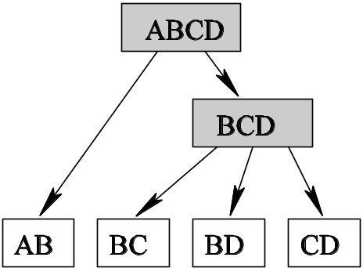
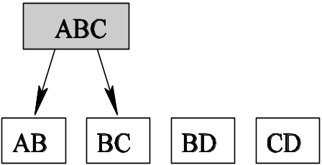
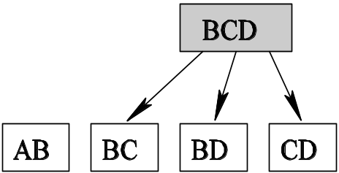
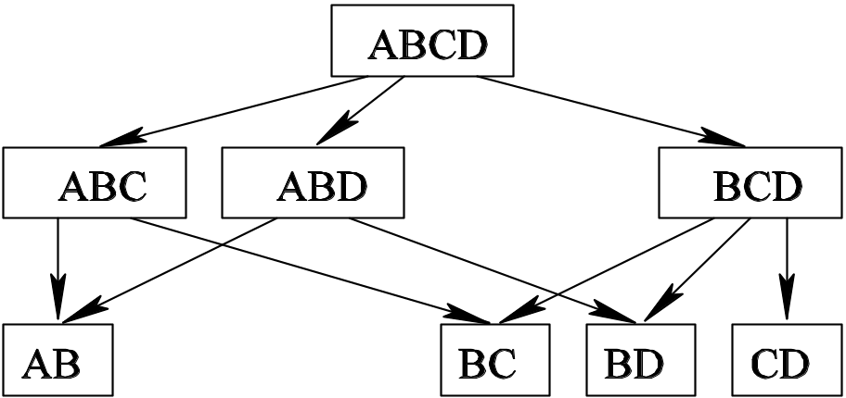
More Phantoms
Relation R contains attributes A, B, C, D.
Queries: group by AB, BC, BD, CD
Relation feeding graph

Slide 18
Outline
Introduction
  Query example and Gigascope
  Single aggregation
  Multiple aggregations
  Problem definition
Algorithmic strategies
Analysis
Experiments
Conclusion and future work

Slide 19
Problem definition
Constraint: Given fixed size of memory M.
  Guarantee low loss rate when evicting everything at the end of time window
  Size should be small to fit in L3 cache
  Hardware (the network card) memory size limit.
Problems:
  1) Phantom choosing.
    Configuation: a set of queries and phantoms.
  2) Space allocation.
    x ∝ g/b
Objective: Minimize the cost.
Notes:
According to the collision rate analysis, which we would show later, collision rate is approximately proportional to g/b. where g is the number of groups of the relation and b is the number of buckets in the hash table. g is estimated according to the previous time window, which is a known parameter.

Slide 20
The View Materialization Problem
psc 6M
pc 6M
ps 0.8M
sc 6M
p 0.2M
s 0.01M
c 0.1M
none 1

Slide 21
Differences
View Materialization Problem | Multi-aggregation problem
If a view is materialized, it uses a fixed size of space. | If a phantom is maintained, it can use a flexible size of space. The smaller the space used, the higher the collision rate of the hash table.
Materializing a view is always beneficial. | Maintaining a phantom is not always beneficial. High collision rate hash tables increase the overall cost.

Slide 22
Outline
Introduction
  Query example and Gigascope
  Single aggregation
  Multiple aggregations
  Problem definition
Algorithmic strategies
Analysis
Experiments
Conclusion and future work

Slide 23

Algorithmic Strategies
Brute-force: try all possibilities of phantom combinations and all possibilities of space allocation
  Too expensive.
Greedy by increasing space used
  (hint: x ≈ g/b , see analysis later)
  b =φg , φ is large enough to guarantee a low collision rate.
Greedy by increasing collision rate (our proposal)
  modeling the collision rate accurately.
Notes:
The first strategy is the brute-force algorithm, that is, we try all the possible combinations of the phantoms and all possibilities of space allocation. This guarantees to find out the optimal configuration and space allocation, but it is too expensive.
The second strategy is trying to adapt the greedy algorithm of the view materialization problem. To adapt it, we need to first, make the size of the hash table fixed given a relation to maintain; second, guarantee that the hash table has a low collision rate. As mentioned, collision rate x is proportional to g, the number of groups of the relation, therefore, we can let b be phi g, where phi is a large value so that x is small. This also makes the hash table size fixed.
The adapted algorithm works as follows. Initially, the configuration contains only the queries. We try with every phantom not in the configuration to see if this phantom is added, what the cost is. Then we add the one with the largest cost save per unit space, or we say the most beneficial one. We do this until the space runs out.
But this strategy has two drawbacks: 1) phi may be too conservative so as to prevent us from adding beneficial phantoms because the space is used out. 2) the proportional space allocation is not optimal
Therefore we propose the other greedy strategy. We always use all the space for the relations in the configuration. As we add phantoms, the space allocation changes and we get a new cost. We add the phantom greedily until the cost does not increase any more. For this strategy, we have to model the collision rate accurately in order to calculate the cost.
The following example shows the difference of the two strategies.

Slide 24
Algorithmic Strategies
Brute-force: try all possibilities of phantom combinations and all possibilities of space allocation
  Too expensive.
Greedy by increasing space used
  (hint: x ≈ g/b , see analysis later)
  b =φg , φ is large enough to guarantee a low collision rate.
Greedy by increasing collision rate (our proposal)
  modeling the collision rate accurately.

Slide 25
Algorithmic Strategies
Brute-force: try all possibilities of phantom combinations and all possibilities of space allocation
  Too expensive.
Greedy by increasing space used
  (hint: x ≈ g/b , see analysis later)
  b =φg , φ is large enough to guarantee a low collision rate.
Greedy by increasing collision rate (our proposal)
  modeling the collision rate accurately.

Slide 26
Algorithmic Strategies
Brute-force: try all possibilities of phantom combinations and all possibilities of space allocation
  Too expensive.
Greedy by increasing space used
  (hint: x ≈ g/b , see analysis later)
  b =φg , φ is large enough to guarantee a low collision rate.
Greedy by increasing collision rate (our proposal)
  modeling the collision rate accurately.
Notes:
Then we get the largest cost save

Slide 27
Algorithmic Strategies
Brute-force: try all possibilities of phantom combinations and all possibilities of space allocation
  Too expensive.
Greedy by increasing space used
  (hint: x ≈ g/b , see analysis later)
  b =φg , φ is large enough to guarantee a low collision rate.
Greedy by increasing collision rate (our proposal)
  modeling the collision rate accurately.

Slide 28
Algorithmic Strategies
Brute-force: try all possibilities of phantom combinations and all possibilities of space allocation
  Too expensive.
Greedy by increasing space used
  (hint: x ≈ g/b , see analysis later)
  b =φg , φ is large enough to guarantee a low collision rate.
Greedy by increasing collision rate (our proposal)
  modeling the collision rate accurately.

Slide 29
Algorithmic Strategies
Brute-force: try all possibilities of phantom combinations and all possibilities of space allocation
  Too expensive.
Greedy by increasing space used
  (hint: x ≈ g/b , see analysis later)
  b =φg , φ is large enough to guarantee a low collision rate.
Greedy by increasing collision rate (our proposal)
  modeling the collision rate accurately.

Slide 30
Algorithmic Strategies
Brute-force: try all possibilities of phantom combinations and all possibilities of space allocation
  Too expensive.
Greedy by increasing space used
  (hint: x ≈ g/b , see analysis later)
  b =φg , φ is large enough to guarantee a low collision rate.
Greedy by increasing collision rate (our proposal)
  modeling the collision rate accurately.

Slide 31
Algorithmic Strategies
Brute-force: try all possibilities of phantom combinations and all possibilities of space allocation
  Too expensive.
Greedy by increasing space used
  (hint: x ≈ g/b , see analysis later)
  b =φg , φ is large enough to guarantee a low collision rate.
Greedy by increasing collision rate (our proposal)
  modeling the collision rate accurately.
  Jump
Notes:
For the adapted algorithm, when we find the most beneficial phantom, we add it to the configuration and allocate space phi g to it. Then we find the most beneficial one from the rest phantoms and add it. Until the space runs out, we stop. For our proposed strategy, when we get the first phantom, all space is allocated to it. When the second one is added, the space is reallocated. The new phantom feeds some relations, which is a positive effect, but it reduces other relations’ hash table size and increase their collision rates, which is a negative effect. As more phantoms added in, the negative effect would exceed the positive effect at some point and then we stop. According to the ways the two algorithms work, we call the first one “greedy by increasing space used” and the second one “greedy by increasing collision rate”

Slide 32
Outline
Introduction
  Query example and Gigascope
  Single aggregation
  Multiple aggregations
  Problem definition
Algorithmic strategies
Analysis
Experiments
Conclusion and future work

Slide 33
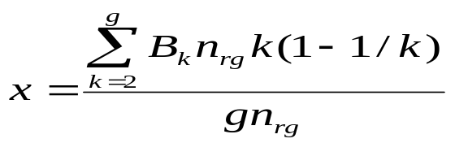
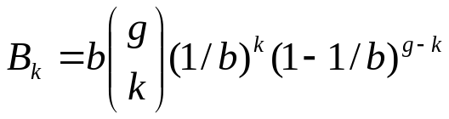
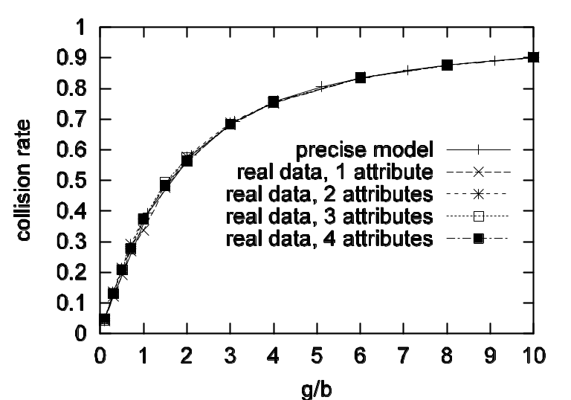
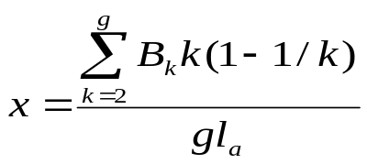
Collision Rate Model
Random data distribution
  n_{rg} : expected number of records in a group
  k : number of groups hashing to a bucket
  n_{rg} k: number of records hashing to a bucket
  Random hash: probability of collision 1 – 1/k
  n_{rg} k(1-1/k): number of collisions in the bucket
  g : total number of groups
  b : total number of buckets
, where
Clustered data distribution
  l_{a} : average flow length
Notes:
So we did some probabilistic analysis on the collision rate. I would omit the details but only highlight some results. The result is that the collision rate is approximately a function of g/b, which is shown by this figure. And we can also see that the curves drawn from the experimental results on real data match the model very well.
Now we already have the collision rate model. We still need the space allocation scheme to find out the optimal solution.

Slide 34
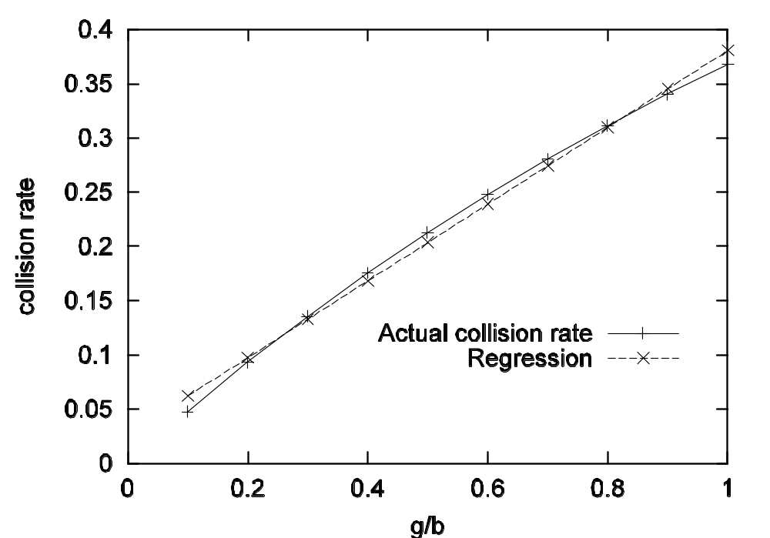

The Low Collision Rate Part
Phantom is beneficial only when the collision rate is low, therefore the low collision rate part of the collision rate curve is of interest.
Linear regression:
Notes:
As only the low collision rate hash tables can be beneficial, we are interested in the low collision rate part of this curve. We zoom in to the low collision rate part and find that it is approximately a linear function of g/b, which is important for the space allocation analysis.

Slide 35
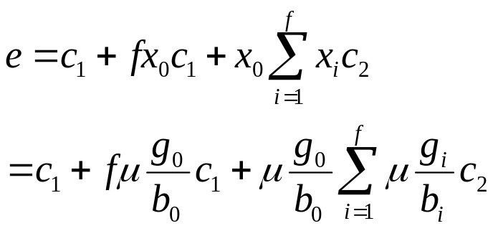
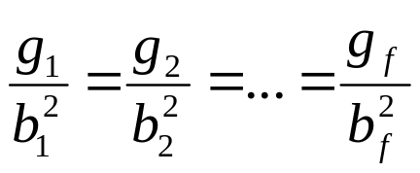
Space Allocation: The Two-level case
One phantom R₀ feeding all queries R₁, R₂, …, R_{f.} Their hash tables’ collision rates are x₀, x₁, …, x_{f.}
Let partial derivative of e over b_{i} equal 0.
Result: quadratic equation.
Notes:
Next we will do the space allocation analysis. We start from the simple case, where we have one phantom R0 feeding all the queries R1, R2, … and Rf, where f is the fan out. Like before, we can calculate the cost e. Then we replace collision rate x by ug/b and get a multivariable function over b0, b1, ..., and bf. To find the minimum, we let the partial derivatives of the equation equal 0 and they result in a quadratic equation. We are happy since we solve it and get the optimal space allocation for the two-level case. It is interesting that the number of buckets should be proportional to the square root of the number of groups.

Slide 36
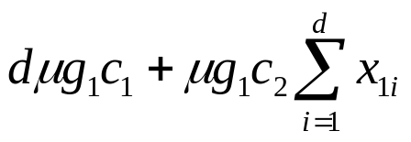
Space Allocation: General cases
Resulted in equations of order higher than 4, which are un solvable algebraically (Abel’s Theorem).
Partial results:
  b₁² is proportional to
Heuristics:
  Treat the configuration as
  two-level cases recursively.
  Supernode.
Implementation:
  SL: Supernode with linear combination of the number of groups.
  SR: Supernode with square root combination of the number of groups.
  PL: Proportional linearly to the number of groups.
  PR: Proportional to the square root of the number of groups.
  ES: Exhaustive space allocation.
Supernode
Notes:
When we try to extend the analysis to the more general cases where we have more than 2 levels, we get equations of order higher than 4, which are unsolvable algebraically. But we still get some partial results which say that the number of buckets should be proportional to the number of groups of itself plus the number of groups of all its children, multiplied by some constants respectively. This means that if a relation is feeding some children, we should add some weights to this relation. Since the general case is unsolvable algebraically, we choose to use heuristics base on the results we can get. Because we know how to deal with the two-level case, we treat the configuration as two-level cases recursively from top down. If any relation has children, we treat it as a supernode and combine the number groups of all the relations in this supernode as the number of groups of this supernode. This would add weight to the parent according to the partial results from the general case. For example, in this configuration, we combine these ones into a supernode and allocate space for the two-level case, where the first level is ABCD, and the second level is AB and the supernode. Then we allocate the space for the supernode within the relations in the supernode, recursively.
In the implementation, we have tried two heuristics based on the analysis but with different ways of building the supernode. We can make number of groups of the supernode as the sum of the number of groups of all the relations in the supernode, which is a linear combination, SL for short. Or we can make the square root of the number of groups of the supernode as the sum of the square roots of the number of groups of the relations in the supernode, which is a square root combination, SR for short. We also implemented some straightforward heuristics for comparison, such as proportional to the number of groups or proportional to the square roots of the number groups, PL and PR for short, respectively. Finally, we implemented the exhaustive method which must find the optimal space allocation.

Slide 37
Outline
Introduction
  Query example and Gigascope
  Single aggregation
  Multiple aggregations
  Problem definition
Algorithmic strategies
Analysis
Experiments
Conclusion and future work

Slide 38
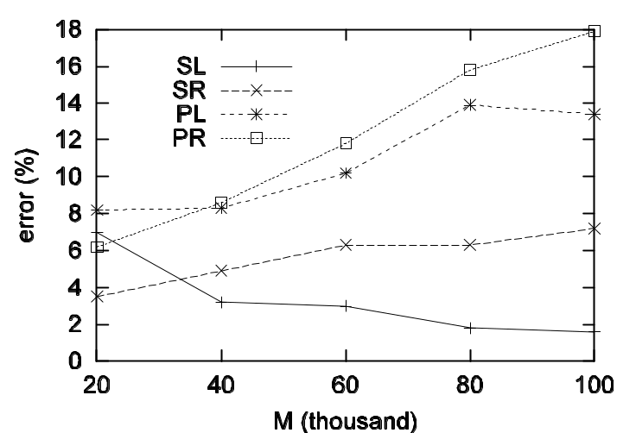
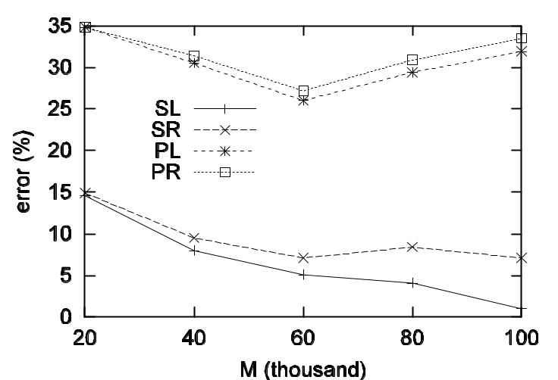
Experiments: space allocation
(ABCD(ABC(A BC(B C)) D))
(ABCD(AB BCD(BC BD CD)))
Comparison of space allocation schemes
  Queries in red; phantoms in blue.
  x-axis: memory constraint ; y-axis: relative error compared to the optimal space allocation.
Heuristics
  SL: Supernode with linear combination of the number of groups.
  SR: Supernode with square root combination of the number of groups.
  PL: Proportional linearly to the number of groups.
  PR: Proportional to the square root of the number of groups.
Result: SL is the best; SL and SR are generally better than PL and PR.
Notes:
First we compare the space allocation schemes. Results on two representative configurations are shown. The x-axis is the memory constraint and the y-axis is the relative cost error compared to the optimal space allocation. We can see that our proposed heuristics based on the analysis are better than other heuristics and the relative error is low, typically less than 15%. SL is best one almost in all cases, therefore we use SL in our phantom choosing.

Slide 39
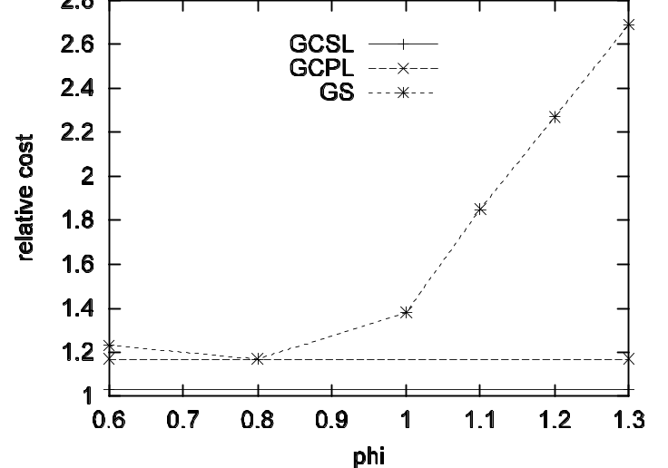
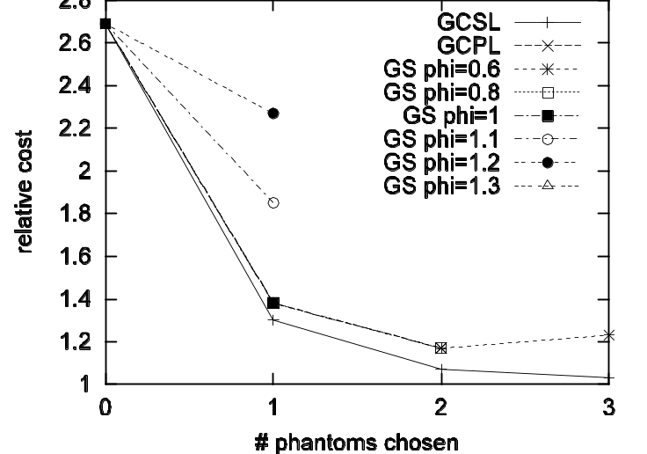
Experiments: phantom choosing
Comparison of greedy strategies
  x-axis: φ ; y-axis: relative cost compared to the optimal cost
Phantom choosing process
  x-axis: # phantom chosen ; y-axis: relative cost compared to the optimal cost
Heuristics
  GCSL: Greedy by increasing Collision rate; allocating space using Supernode with Linear combination of the number of groups.
  GCPL: Greedy by increasing Collision rate; allocating space using Proportional Linearly to the number of groups.
  GS: Greedy by increasing Space. Recall
Results: GCSL is better than GS; GCPL is the lower bound of GS.
Notes:
Next, we compare the phantom choosing strategies.

Slide 40
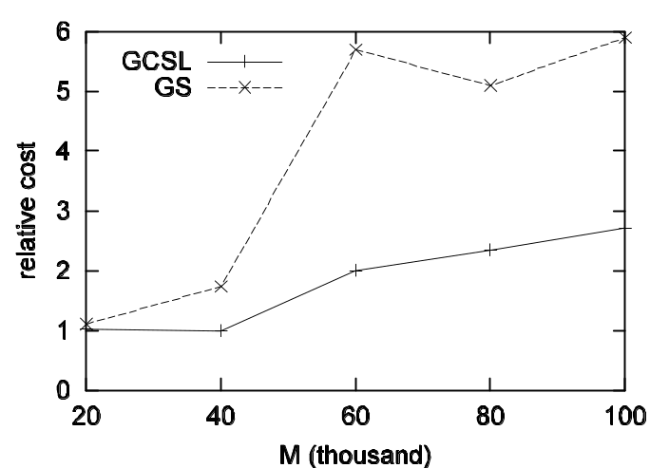
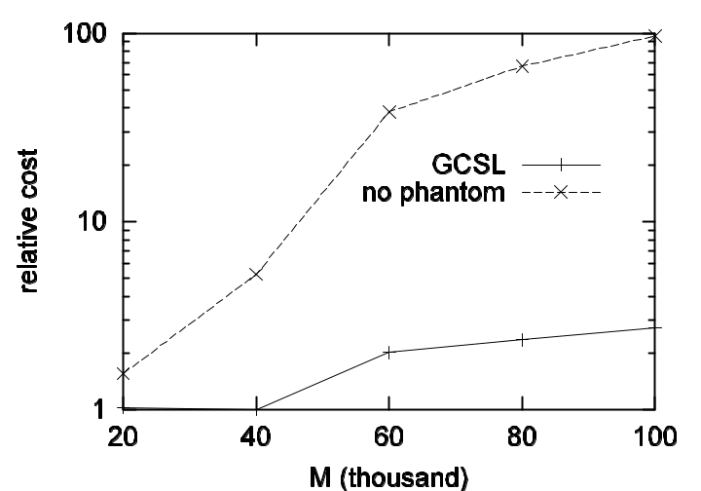
Experiments: real data
GCSL vs. GS
Maintaining phantom vs. No phantom
Experiments on real data
  Actually let the data records stream by the hash tables and calculate the cost.
  x-axis: memory constraint ; y-axis: relative cost compared to the optimal cost.
Results
  GCSL is very close to optimal and always better than GS.
  By maintaining phantoms, we reduce the cost up to a factor of 35.

Slide 41
Outline
Introduction
  Query example and Gigascope
  Single aggregation
  Multiple aggregations
  Problem definition
Algorithmic strategies
Analysis
Experiments
Conclusion and future work

Slide 42
Conclusion and future work
We introduced the notion of phantoms (fine granularity aggregation queries) that has the benefit of supporting shared computation.
We formulated the MA problem, analyzed its components and proposed greedy heuristics to solve it. Through experiments on both real and synthetic data sets, we demonstrate the effectiveness of our techniques. The cost achieved by our solution is up to 35 times less than that of the existing solution.
We are trying to deploy this framework in the real DSMS system.

Slide 43
Questions ?

